Slide 1
Introduction to C# Language and Its History

Slide 2
Agenda
History of C#
C# as Programming Language
Integrated Development Environment (IDE)
Writing your first C# Program
.NET Framework
Key Components of .NET Framework
Getting started with Visual Studio

Slide 3
Brief History of C#
1999 Creation: C# (pronounced "C sharp") was created by Microsoft in the late 1990s.
Anders Hejlsberg: The language was developed by Anders Hejlsberg and his team at Microsoft. Hejlsberg had previously worked on the development of Turbo Pascal and Delphi.
Development by Microsoft: Microsoft aimed to create a language that would be modern, object-oriented, and suitable for building Windows applications and web services.
.NET Initiative: C# was a key part of Microsoft's .NET initiative, a framework for building and running applications on the Windows platform.

Slide 4
C# as a Modern, Versatile Programming Language
MODERN FEATURES
VERSATILITY
Object-Oriented: C# is an object-oriented programming language, supporting the principles of encapsulation, inheritance, and polymorphism.
Memory Management: It includes automatic memory management through garbage collection, simplifying memory-related tasks.
Type Safety: C# is statically typed, which enhances type safety and catches errors at compile-time rather than runtime.
Cross-Platform Development: While initially associated with Windows development, C# has become more versatile, supporting cross-platform development through technologies like .NET Core and Xamarin.
Multiple Paradigms: C# supports multiple programming paradigms, including imperative, functional, and object-oriented programming.

Slide 5
C#'s Role in Software Development and Industry Adoption
SOFTWARE DEVELOPMENT
INDUSTRY ADOPTION
Desktop Applications: C# is widely used for developing desktop applications, especially on the Windows platform.
Web Development: With ASP.NET, C# is a popular choice for web development, enabling the creation of dynamic and scalable web applications.
Game Development: C# is employed in game development through the Unity game engine, making it a significant player in the gaming industry.
Enterprise Solutions: Many large enterprises use C# for building robust and scalable enterprise-level applications.
Community Support: C# has a strong community and is supported by Microsoft, ensuring regular updates, security patches, and continuous improvement.
Integration with Microsoft Technologies: C# seamlessly integrates with other Microsoft technologies, such as Azure cloud services and SQL Server databases, contributing to its widespread adoption.

Slide 6
Integrated Development Environment (IDE)
IDE stands for Integrated Development Environment. An IDE is a software suite that combines various tools and features to facilitate software development. It provides a comprehensive and unified interface for developers to write, test, and debug their code efficiently. The key components of an IDE typically include:

Slide 7
Visual Studio as an IDE
Code Editor: A text editor that allows developers to write, edit, and view code. It often comes with features like syntax highlighting, autocompletion, and code folding.
Debugger: Tools for debugging code, including setting breakpoints, stepping through code execution, inspecting variables, and identifying errors.
Compiler/Interpreter: Functionality to compile or interpret code, depending on the programming language, to convert it into machine code or bytecode that can be executed.
Build Automation: Tools to automate the build process, ensuring that code is compiled, linked, and packaged correctly.
Version Control Integration: Support for version control systems (e.g., Git, SVN) to track changes, collaborate with other developers, and manage different versions of the code.

Slide 8
Visual Studio as an IDE
Project Management: Features to organize and manage projects, including file organization, project templates, and configuration settings.
Integrated Documentation: Tools to generate and view documentation directly within the IDE, helping developers understand and document their code.
Code Navigation: Features that aid in navigating through code, such as "Go to Definition," "Find References," and code outlining.
Testing Tools: Facilities for running and managing tests, including unit testing frameworks and test result reporting.
Deployment Tools: Options to deploy applications or components directly from the IDE.

Slide 9
Selecting the Right IDE
Productivity:
A well-designed IDE enhances developer productivity by providing tools like code completion, debugging, and project management in one environment.
Reduces the need to switch between different tools, saving time and effort.
Code Quality:
A good IDE offers features like code analysis, refactoring tools, and version control integration, contributing to improved code quality.
Helps identify and fix issues early in the development process.
Collaboration:
Integrated version control and collaboration features facilitate team development.
Choosing an IDE with robust collaboration tools ensures seamless teamwork.
Learning Curve:
The right IDE should be user-friendly, with a manageable learning curve.
Developers can quickly adapt to the environment, accelerating the onboarding process for new team members.

Slide 10
Selecting the Right IDE
Ecosystem and Integration:
An IDE with a rich ecosystem of extensions and plugins allows developers to tailor their environment to specific needs.
Integration with other tools and technologies simplifies workflows.
Community Support:
A popular and well-supported IDE often has a vibrant community.
Access to forums, documentation, and community resources aids problem-solving and skill development.
Platform Compatibility:
Depending on project requirements, selecting an IDE that supports the targeted platforms (Windows, macOS, Linux) is crucial for cross-platform development.

Slide 11
Writing Your First C# Program
Step 1: Opening Visual Studio 2022
Open Visual Studio 2022 on your computer.
Step 2: Creating a New Project
Click on "Create a new project."
Choose a template based on your application type. For a console application, you might select "Console App (.NET Core)".
Provide a name for your project, and choose a location to save it.
Click "Create."

Slide 12
Writing Your First C# Program
Step 3: Writing the "Hello World" Code
In the newly created project, you'll see a file named Program.cs. Double-click to open it.
In the editor, you'll see a template with the Main method. Replace its content with the following code:
using System;
class HelloCSharp
{
static void Main()
{
Console.WriteLine("Hello, C#");
}
}

Slide 13
Include the standard namespace "System"
Define a class called "HelloCSharp"
Define the Main() method – the program entry point
using System;
class HelloCSharp
{
static void Main()
{
Console.WriteLine("Hello, C#");
}
}
Print a text on the console by calling the method "WriteLine" of the class "Console"

Slide 14
Class names should use PascalCase and start with a CAPITAL letter.
using System;
class HelloCSharp
{
static void Main()
{
Console.WriteLine("Hello, C#");
}
}
The { symbol should be alone on a new line.
The } symbol should be under the corresponding {.
The block after the { symbol should be indented by a TAB.

Slide 15
Running the Program
Save the changes (Ctrl + S).
Press F5 or click on the "Start Debugging" button (usually a green arrow) to build and run your program.
Viewing Output
You should see the output in the console window at the bottom, displaying "Hello, World!"

Slide 16
Primitive Data Types
int - stores whole numbers
double - stores floating points, numbers with decimals
char - single character ‘c’
string - text “Hello Class!”
bool - stores true and false

Slide 17
Creating a Variable
type variable name = value;
string name = “Dr. Nishant ”;
int i = 199;
char c = ‘a’;
double d = 99.99d;
bool value = true;

Slide 18
Constants
Storing the values that does not change. For example, value pi = 3.14 or value constant g
const double pi = 3.14d;
const double g = 9.8d;

Slide 19
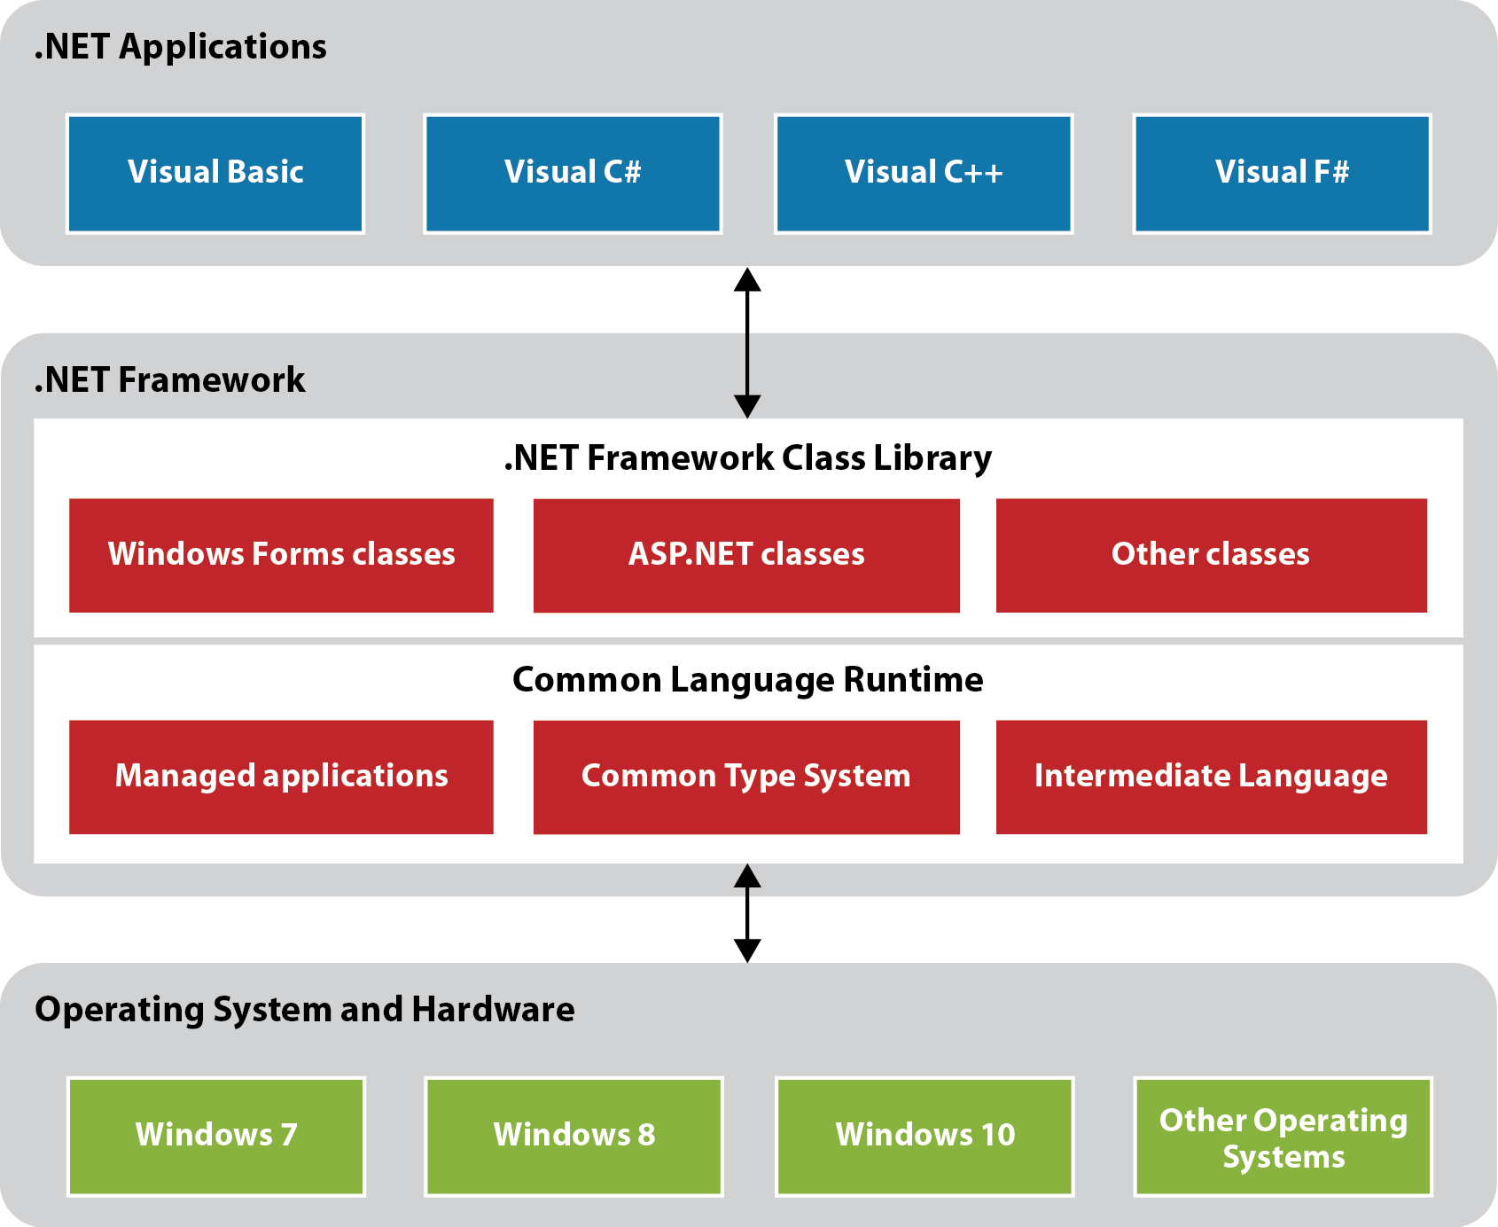
The .NET Framework

Slide 20
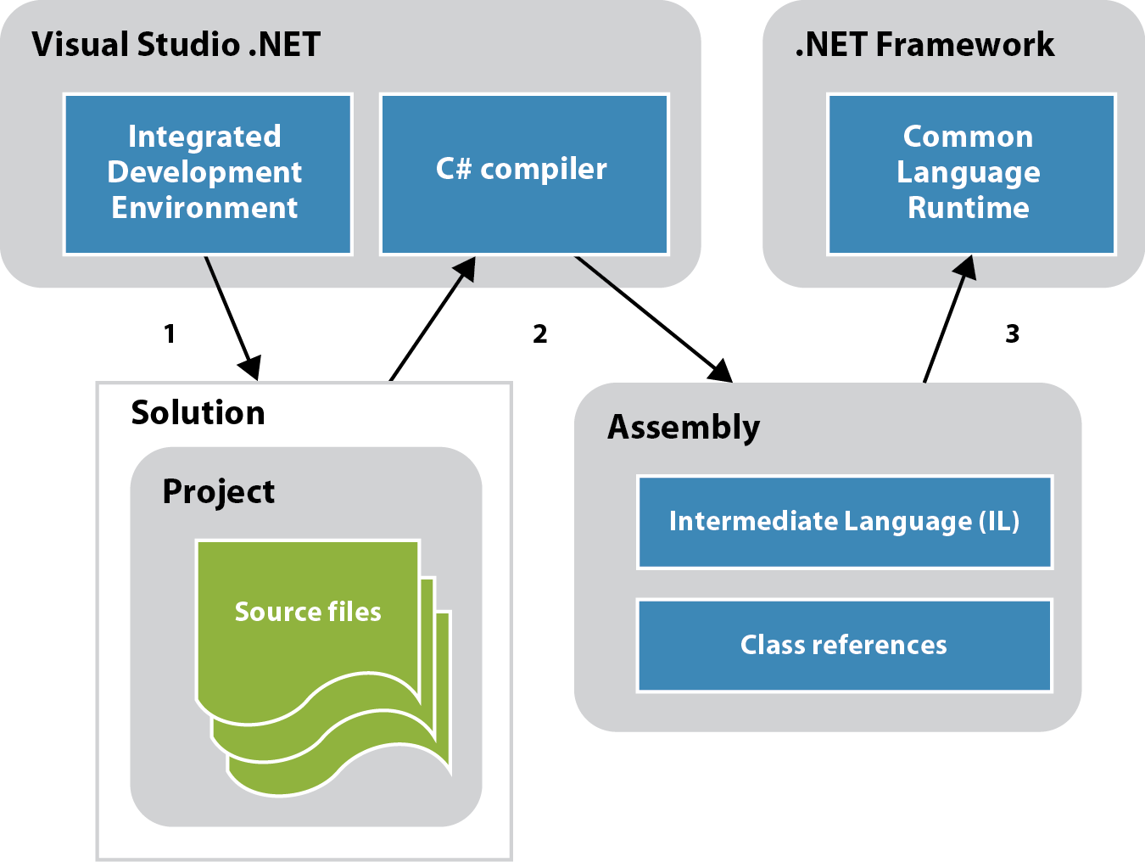
How C# Program is Compiled and Run

Slide 21
Key Components of .NET Framework
Common Language Runtime (CLR):
Execution Engine: Translates Intermediate Language (IL) code into machine code at runtime.
Memory Management: Handles memory allocation and garbage collection.
Security: Enforces code access security and provides other security features.
.NET Class Library:
Reusability: Contains a set of libraries that developers can use to perform common tasks without having to write code from scratch. Promotes consistency in coding practices across different applications.
Consistency: Common Type System (CTS):
Unified Type System: Ensures types written in one .NET language can be used seamlessly by others, enhancing interoperability.
Common Intermediate Language (CIL):
Intermediate Code: Compiled code that is platform-agnostic. Translated to machine code by the CLR at runtime.
Assemblies:
Deployment Units: Assemblies are the basic units of deployment in .NET, containing compiled code, metadata, and resources.

Slide 22
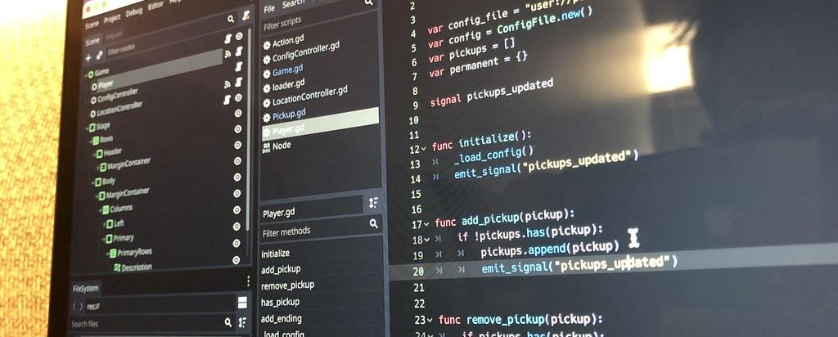
Visual Studio 2022 Overview
Overview of the IDE in the in-class Lab and creating your first program

Slide 23
Course Learning Outcomes
1.1 Examine basic computing concepts
1.2 Survey C# history and how it is constructed.
1.3 Classify the elements of a C# program.
1.4 Evaluate the program development process

